Slide 1
Speed detector
Group 6 : CHENKAI WEI
JIACHENG SHI
YIHAN NIU
KONSTANTINOS KOSTOVASILIS

Slide 2
Project description
Generate Impulse Signals
Laser based speed detector for better range and accuracy
Applications :
Law Enforcement
Calibration Purposes
Accurately Measuring Distance
What it does
Instant/Average/Highest
Distance
How it does
Receive Reflection Wave
Measure Distance
Calculate Speed
LCD Display

Slide 3
Hardware
MSP430
Temperature and Humidity Sensor
Laser Generator
Extending Interval Circuit
Laser Receiver
(APD)
Specific
Power Supply

Slide 4
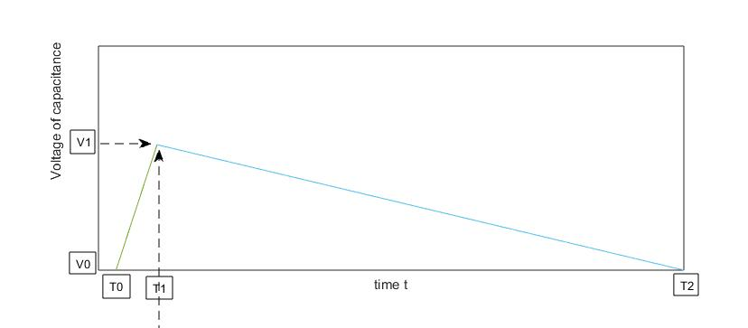
key component
Background
fmax of MSP430 : 16MHz
1m 150MHz
Method
Charge Capacitance
Discharge
T2-T1=k(T1-T0)

Slide 5
software
Receive Signal from the Button on Board
IAR Embedded Workbench
Used for Uploading on the MSP430
Generate Signal Using PWM Output
From P1.7
Receive Signal
Record Time Interval of Two Impulses
Calculate Distances and Speed
Display on LCD
Use Switches to Enable Different Operations
Generate Impulse (PWM)
Receive Signal from Extending Interval Circuit
Calculate Interval, Distance & Speed
Display on LCD

Slide 6
Thank you ! Any questions ?

